Slide 1
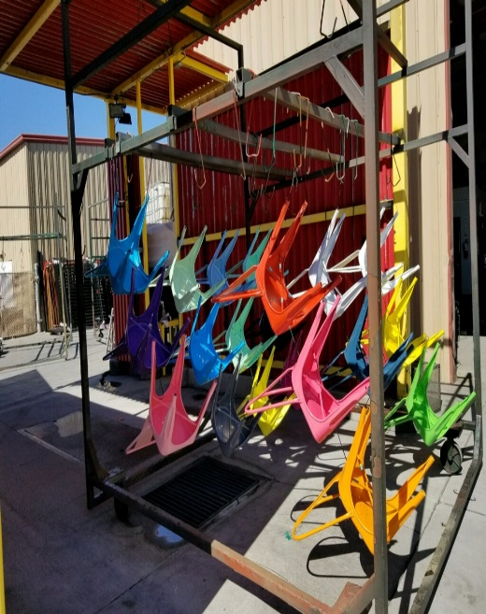
“Funky Finishes”
Sercy Spears
TIGER Drylac, U.S.A., Inc.
SFEA (Surface Finishers Educational Association)
November 14, 2019 Anaheim, CA

Slide 2

Who is TIGER Drylac?
World Headquarters – Wels, Austria
Manufacturer of Quality Finishes since 1930
One of the first manufacturers of Powder Coatings 1968
North America Introduction 1985
Third Generation Family Owned Business
  1,184 Estimated Employees
TIGER ranks as the 5th largest producer worldwide 2019
  $362M - 2018
Currently serves over 50 countries
9 Global Manufacturing Sites
  St. Charles, Illinois – US Headquarters

Slide 3
TIGER World Headquarters – Wels, Austria

Slide 4
What are Powder Coatings?
Coatings Applied as Powder Particulate to a Given Surface
Solid Resins
Curing Agents
Pigments
Additives, Extenders
  Binders, Flow Agents, Metallic, Mica Flake, etc.

Slide 5
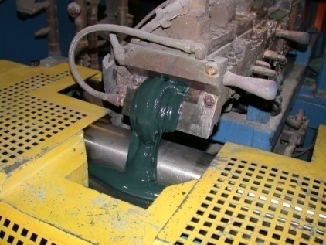
How are Powder Coatings Made and Used?
Premix (Raw Material Weighed Up)
High Speed Mixers and Tumblers
Melt Mix to get a Mixed Plastic Mass
Cool Down on Chill Rollers
“Kibbles and Bit’s” – Flake
Grinding and Air Classification – Particle Size Control
Powder is applied and “stoved” or “cured” to allow 3 dimensional cross-linking – Glass Transition Point
  PMT (Part Metal Temperature) – Time at Temperature
  Hot Flocking – Alternate Cure Method

Slide 6
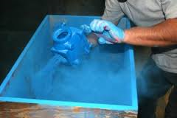
In the Beginning-Fluidized Bed Process
Late 1940s-Flame Spraying of Thermoplastic Powder
1953-Dr. Erwin Gemmer develops Fluidized Bed and applies for a patent
1955-Patent is Issued and Introduced to the U.S. Market
Between 1958 and 1965 – mostly functional 15-50 mils
  Nylon 11, Polyethylene, Plasticized PVC, Polyester and Chlorinated Polyether, Functional Epoxy Resin developed by Bosch®

Slide 7
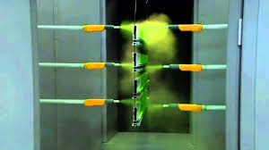
Movers and Shakers-Electrostatic Processing
1962-1964 Fluidized Beds fall out of use replaced by Electrostatic Spray Guns by Sames®
1966-1973 Thermosets Developed
  Epoxy, Epoxy-Polyester Hybrid, Polyurethane, Polyester
1980-Unprecedented Growth
Constant Innovation, Available Commodities, Improved Formulation, advances in Application Technology

Slide 8
Specifications Drive the Marketplace
AWWA – American Water Works Association
AAMA – American Aluminum Manufacturers Association
UL – Underwriters Laboratory
NSF – National Safety Federation
FDA – Food and Drug Administration
BIFMA – Business and Institutional Furniture Manufacturers Association
KCMA – Kitchen Cabinets Manufacturers Association
ITAR, CARC (Department of Defense)
AND MANY MORE………………………………………
Example:
QUALIFICATION OF TIGER DRYLAC’S “HAZE GRAY FED-
STD-595 #26270 (438/72006), TYPE III, CLASSES 2 AND 3
UNDER MIL-PRF-24712B

Slide 9
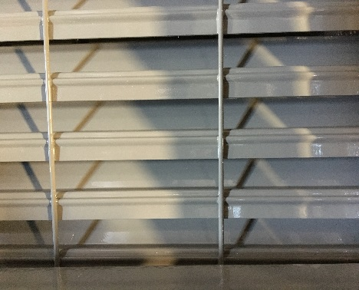
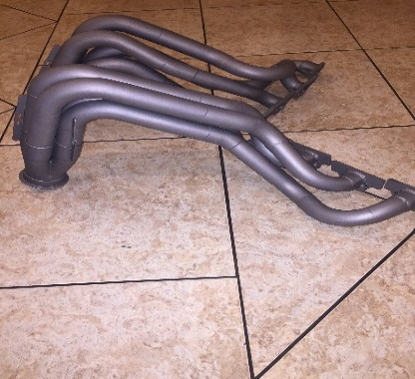
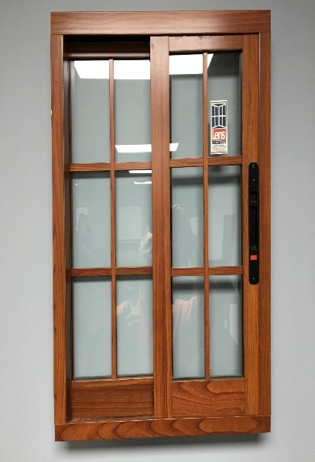

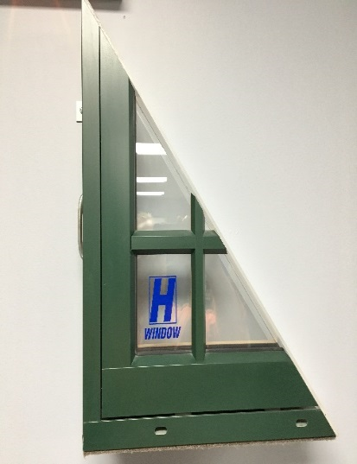
Emerging and Growing Technologies
Anti-Graffiti
Anti-Microbial
Anti-Stats
Abrasion Resistance
Engineered Wood Substrates (MDF)
In Mold Coatings
Post Formable Powders
Anti-Skid
High Heat
Die Sublimation
Glass and Plastics
And More on the Way….

Slide 10

Black and White World
Basic Colors, Base Formulations
Industry Trends are Market Driven

Slide 11
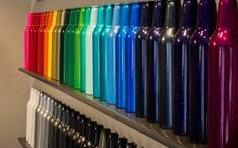
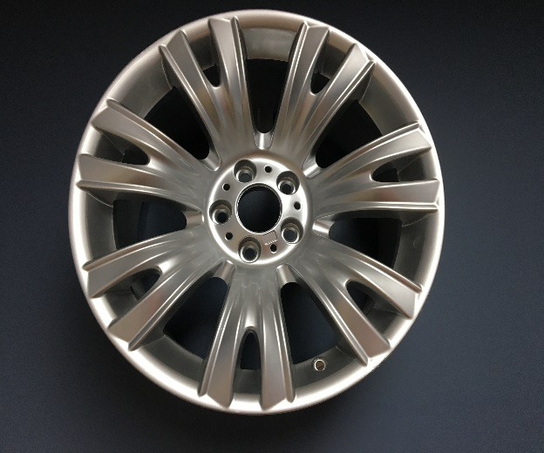
Discovering the Niche Marketplace
Metallic Powder
Bonding, Veining, Leafing, Texturing
Keys to Success
EVERYTHING STARTS WITH GROUND (EARTHING)
Presentation of Part (secure the part do not let it flop around)
Fluidization (not Gravity Feed or Vibratory Feed)
Proper Nozzle Selection
Proper Part to Gun Distance Established
Proper Movement (repeat, repeat, repeat)
Proper kV and Micro Amps Established
Proper time and temperature in Oven

Slide 12
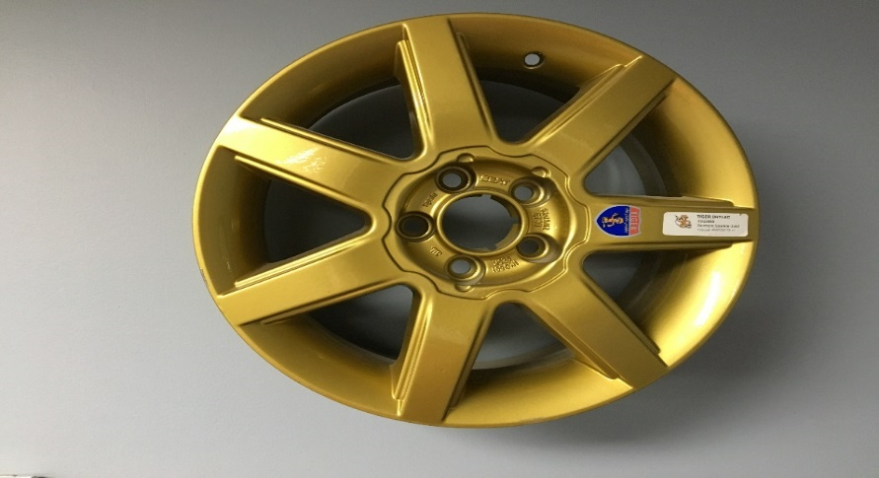
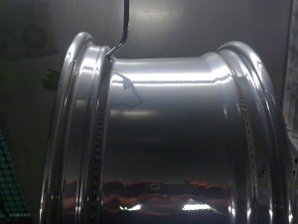
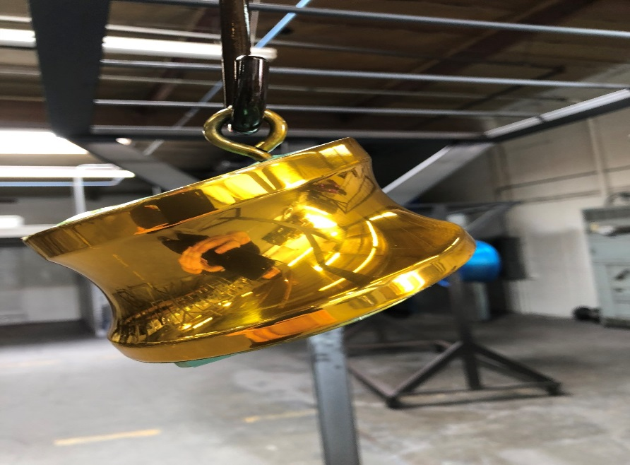
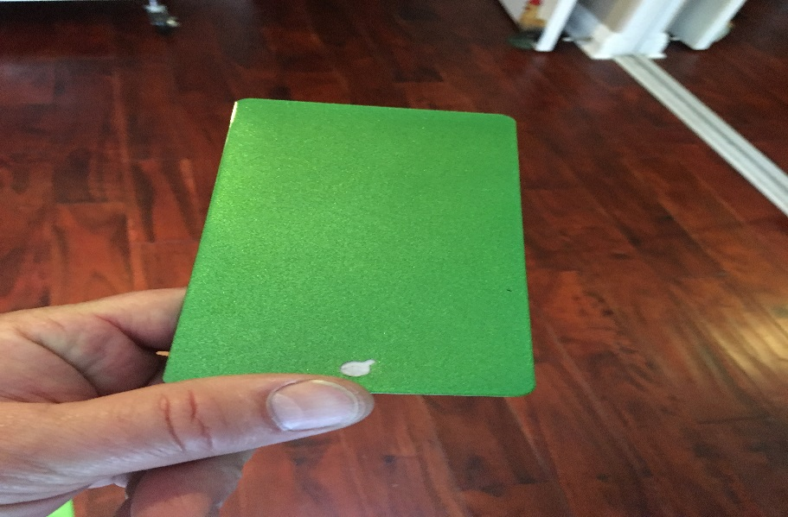
First Articles, VPC (Visual Process Control)

Slide 13
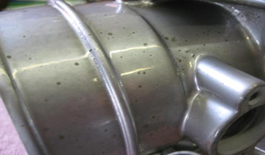
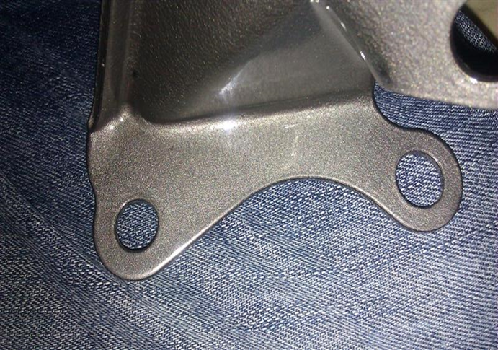
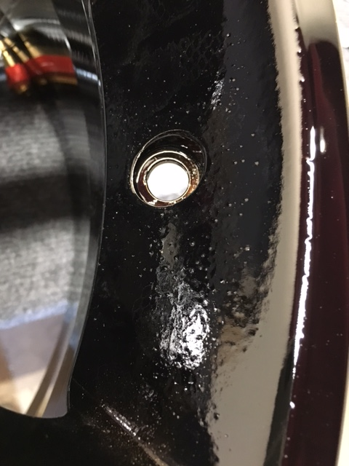
Success or Failure-Don’t Guess
Always Consult the Data Sheet!!!
Leafing Material (Chromes/Golds) Under-Cured before Clear Coat Application

Slide 14
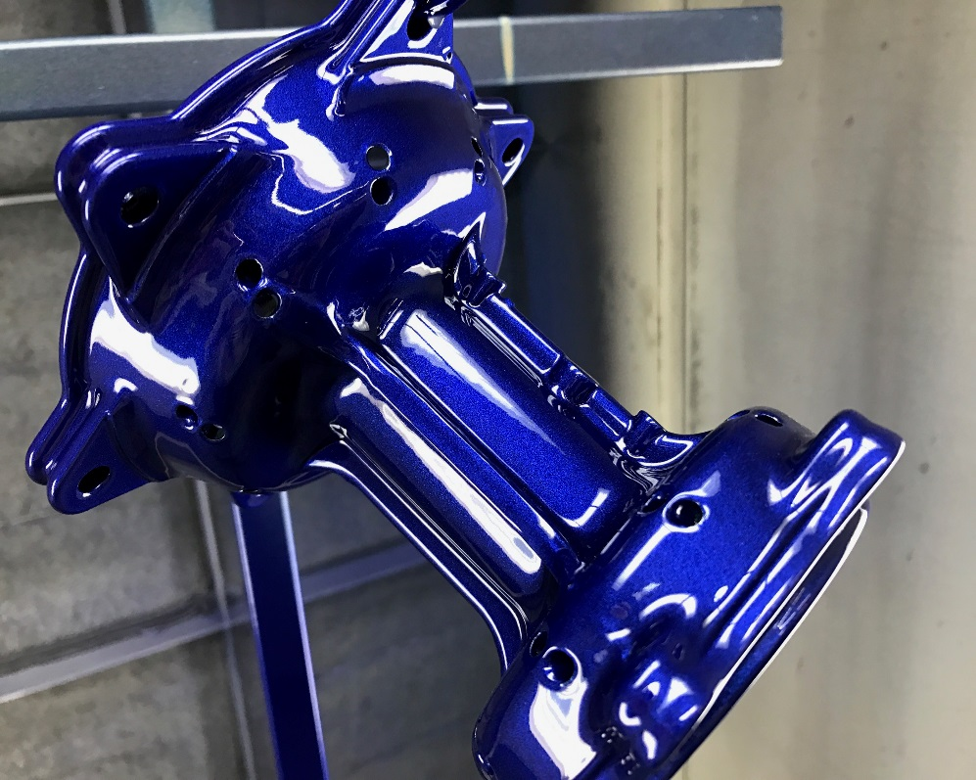
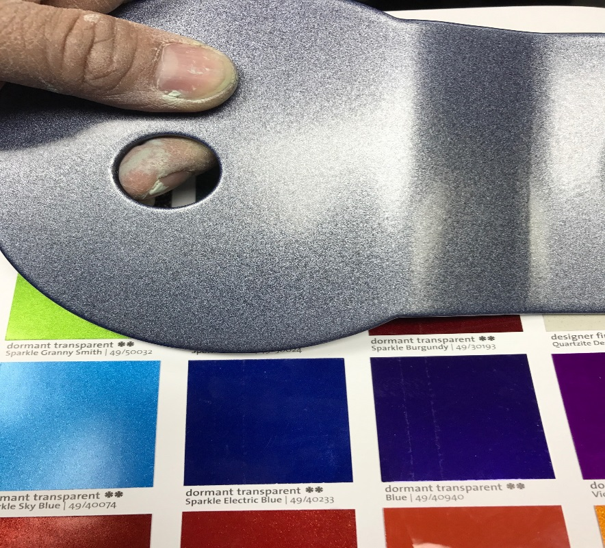
Dormant Powders
Basecoat then Clear Coat and Color Develops
(Inter-Coat Adhesion Issues can occur)

Slide 15
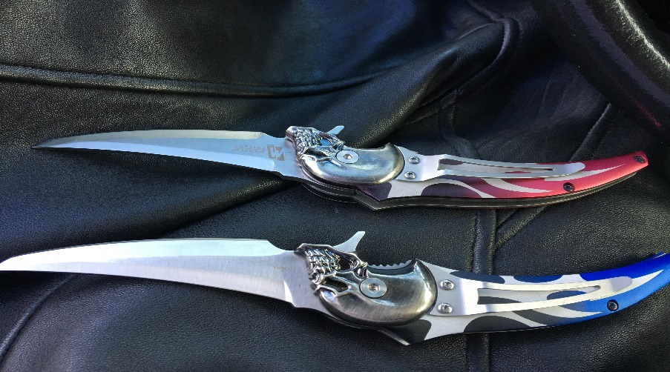
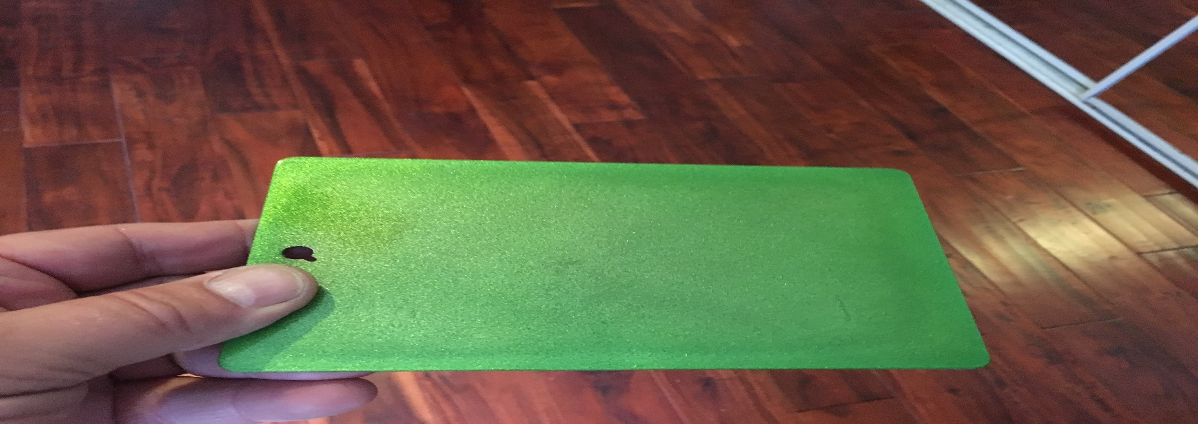
Candies and Translucents
Most causes of failure
Poor or No Ground
Film Build Related
Picture Framing or Hat Banding
Poor Dispersion of Pigment

Slide 16
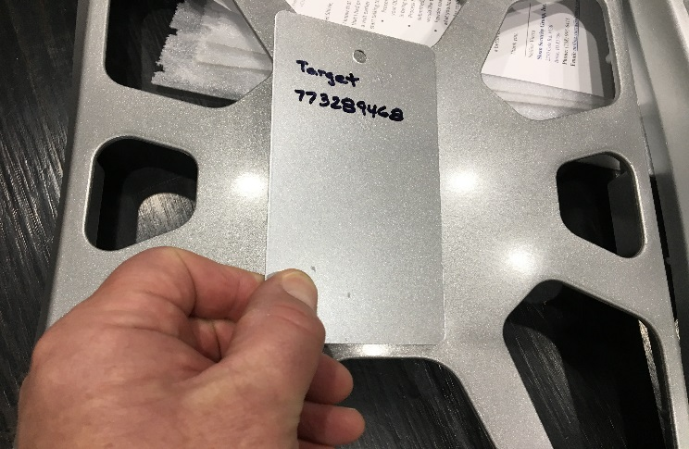
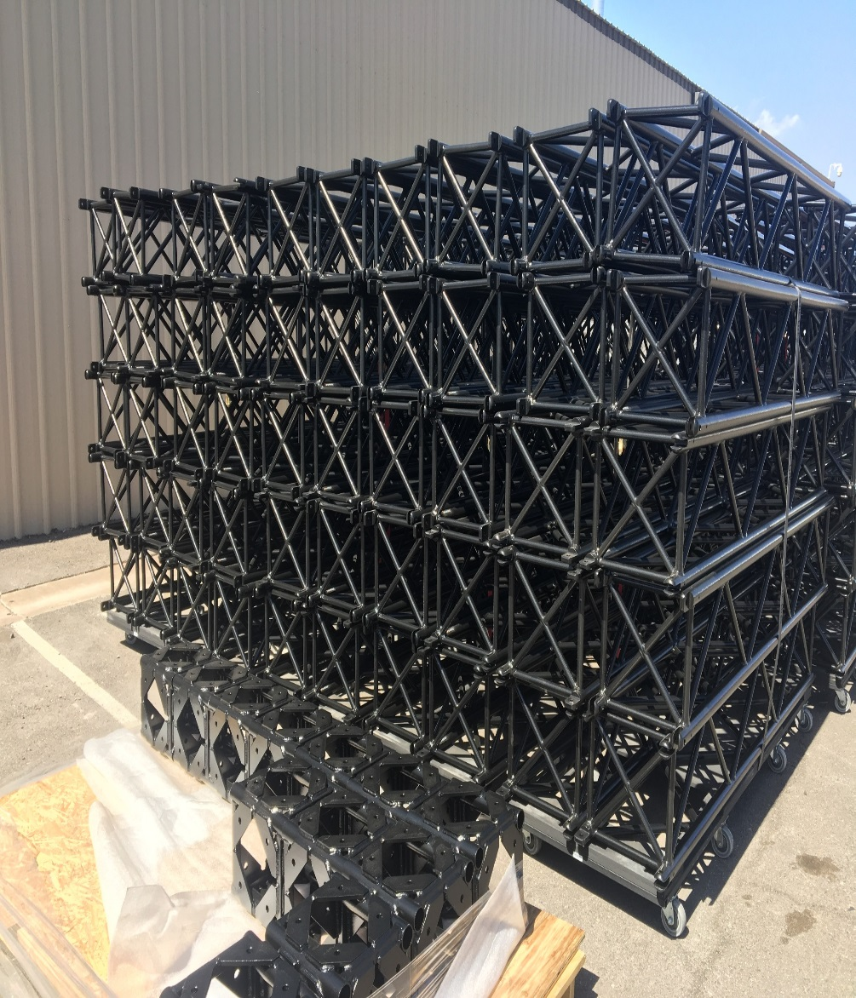
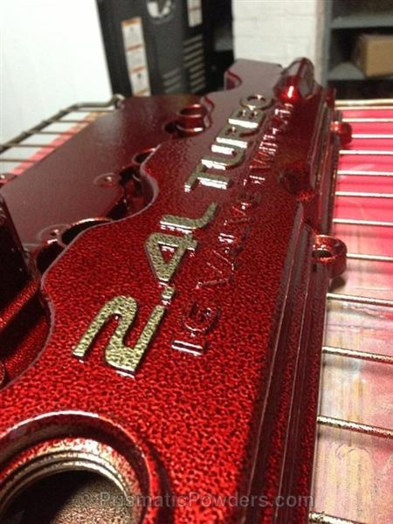
Sparkles, 1 and 2 Coat Processes

Slide 17
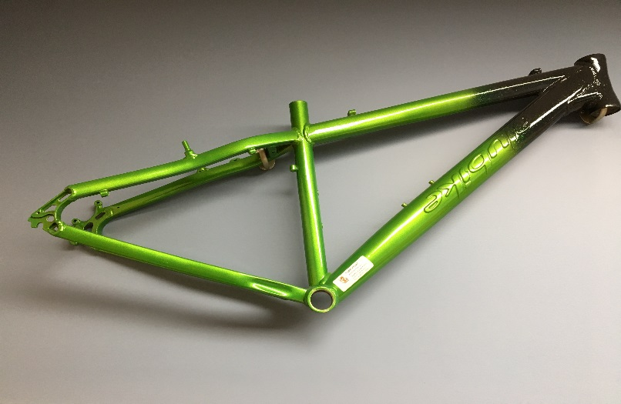
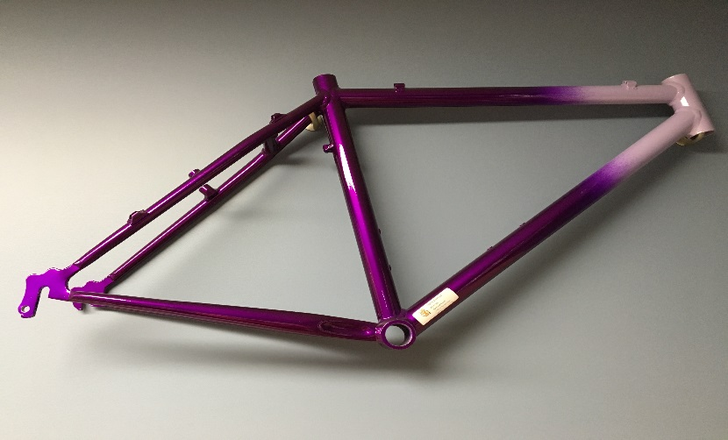
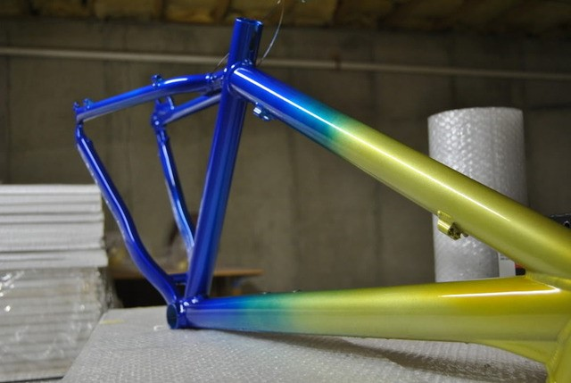
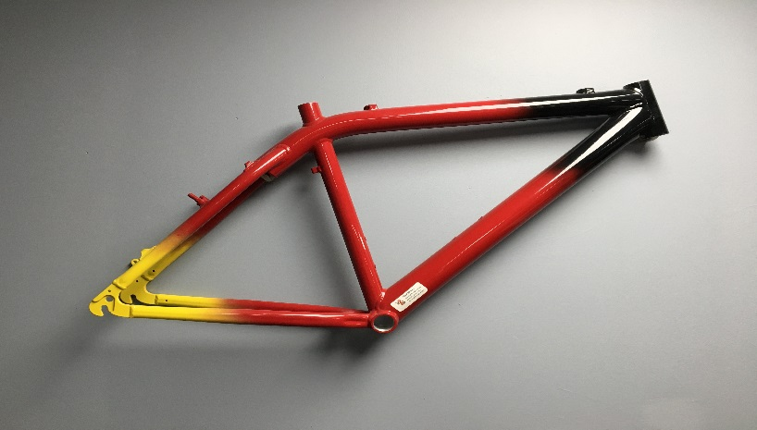
Fades-Time to Play
Only Limit is Imagination and Desire

Slide 18
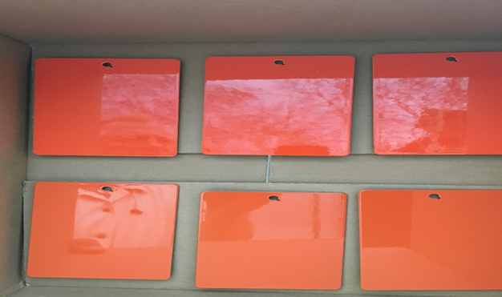
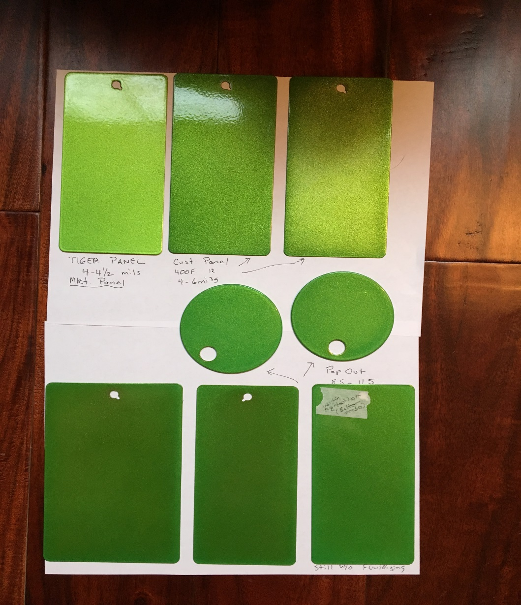
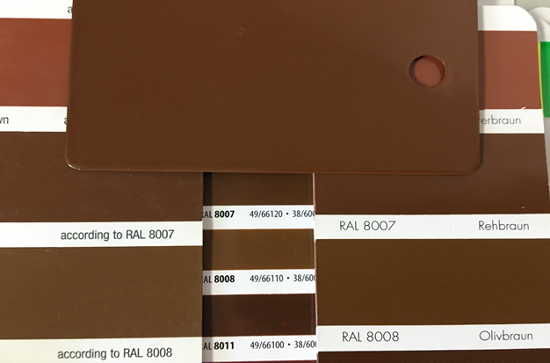
Test, Test, Test then Test Again

Slide 19
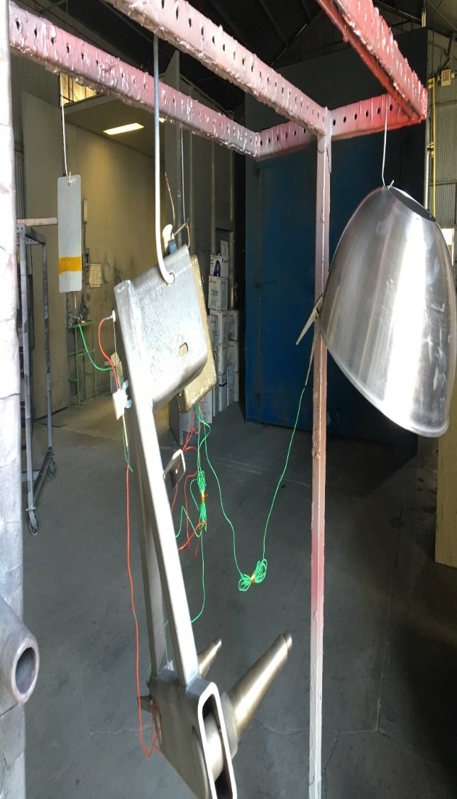

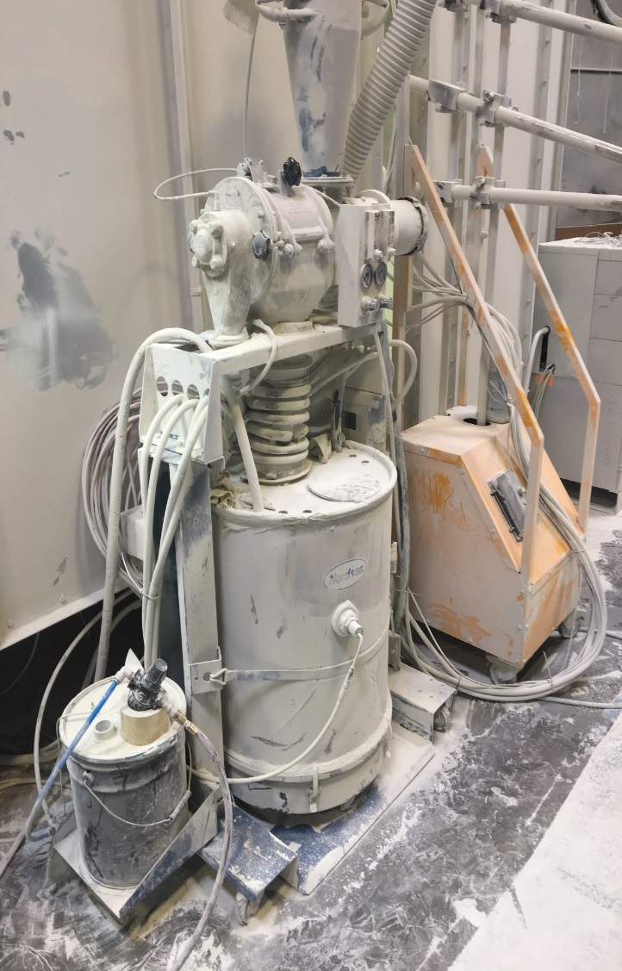
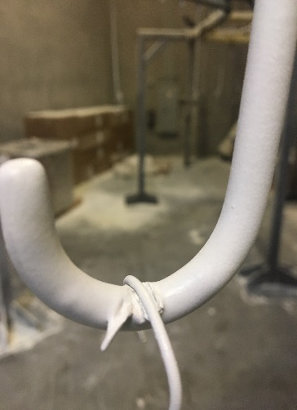
Maintain the Equipment and Verify Data

Slide 20
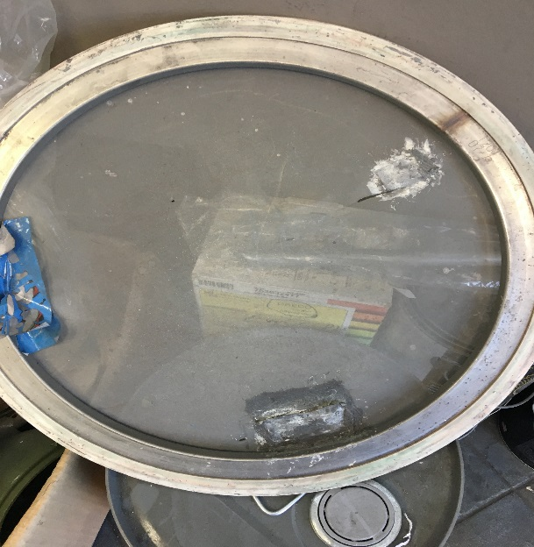
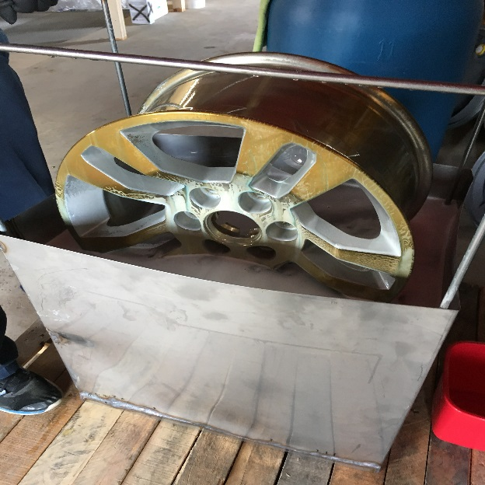
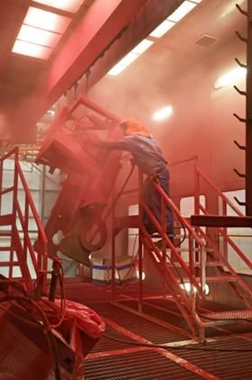
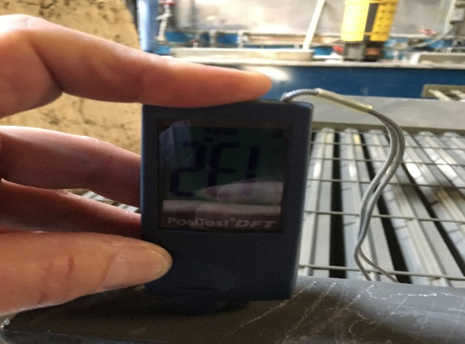
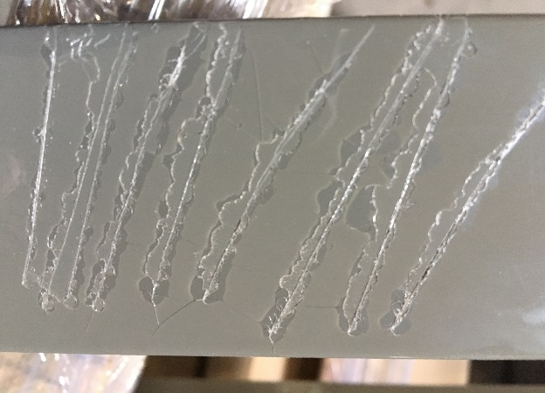
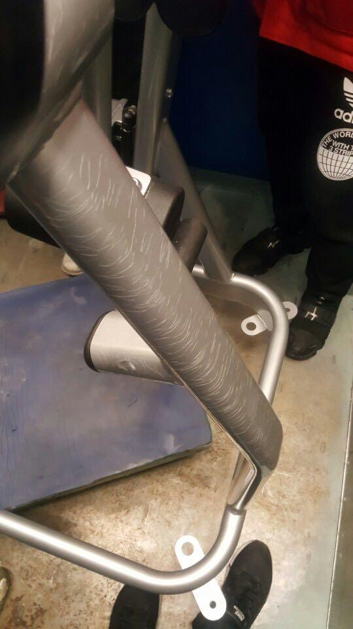
What Not to Do-And What to Watch For

Slide 21
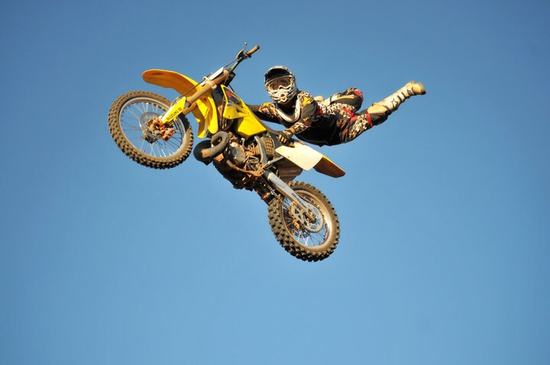
Q & A
QUESTION OR COMMENTS!
THE SKY IS THE LIMIT so SHOOT FOR THE MOON,
but keep a keen watch on your GROUND!

Slide 22
Mandatory guidelines for
YOUR presentation | task-flow
Do you have a convincing story to share?
BEFORE THE PRESENTATION
Define clear goals for YOURSELF, and make sure they are ‘SMART’ goals (“What do I want the result of / the reaction to my presentation to be?”)
Phrase YOUR message, that YOU want to get across, in a crystal-clear way (= essence of the whole presentation in 1 (!) sentence) – this is the core of your presentation
Define the content-matter – the slides are meant to argue your message better, prove it and underpin it with facts (… and not need any explaining!)
Prepare handouts / written materials for your audience – with text (not just keywords but verbs too!) and images
STRUCTURING YOUR PRESENTATION – 2 basic rules: BLUFF and SOCRR
First: Walk out to the screen, have your remote control with Laser pointer ready, look into the eyes of your audience to “read” them while you are presenting. NEVER stay seated and as you are talking everybody looks at the screen – this is an energy killer and deprives you of eye to eye connection.
Your introduction should be a logical ‘way-in’ to your message that gets people’s attention.
State your Main Message at the very beginning: ‘BLUFF’ – Put the Bottom Line Up Front – say right at the outset what it’s basically all about as YOU see it …
Explain the present situation, the problem and the question to be answered, and start by summing up what you have to say: ‘SOCRR’ – Describe the Situation, present Options, present a Comparison, present your Recommendation, Request a decision.
The main part should answer your listeners’ “central question”.
Construct a clear chain of argumentation – a “storyline” – and highlight your message(s)
Use clearly structured, unambiguous and easy-to-understand charts and diagrams as evidence
Use different colors for different areas to emphasize your message – not just as decoration!
Go for high information density, but make sure there is a clear structure (max. 7 ideas/topics on each hierarchical level)
The conclusion should emphasize the message once again
Repeat your message (but without any ‘thank-you’s’ – see below)
DON’TS:
NO animations, decorations etc.:, use standard fonts; be sparing with font styles (bold …), etc.
NO trivial messages and ‘padding’ words
NO ‘thank-you’s’ – it is your listeners who are grateful, for the information they've just received
YOUR GOOD PREPARATION  YOUR SUCCESSFUL PRESENTATION
Remember! “At the end of the day, what counts is not what you have said, but what has got through to your listeners”

