Slide 1
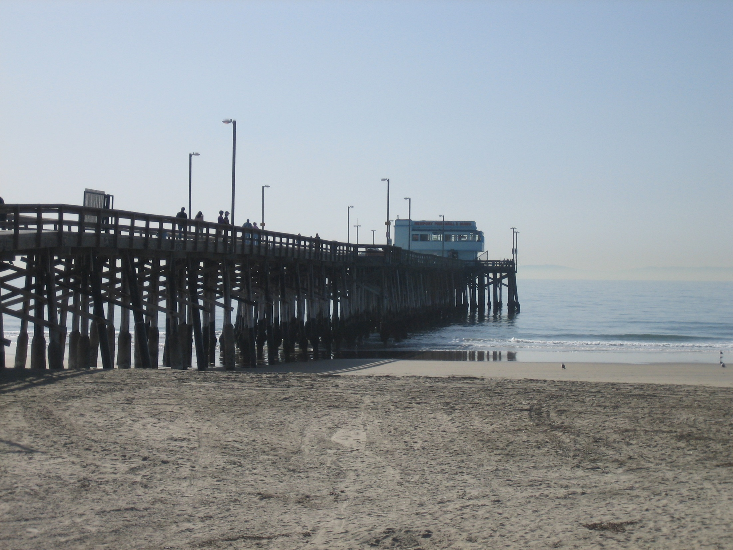
CASS and other Accelerated Corrosion Tests
Presented to the SFEA Surface Finishers Educational Association, Orange County, CA
By: Frank Altmayer, MSF, AESF Fellow, Technical Education Director,
AESF Foundation/NASF

Slide 2
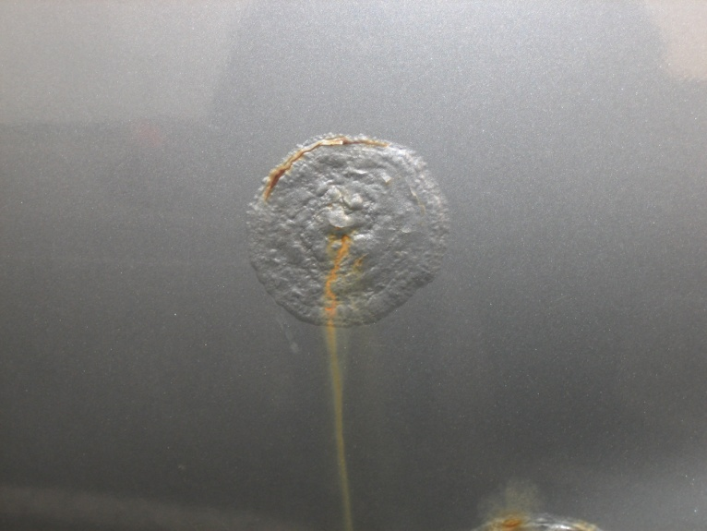
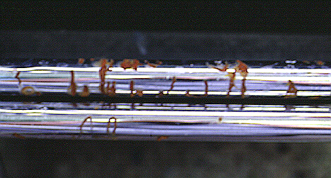
Common Corrosion Mechanisms
Chemical attack
Bi-metallic (aka galvanic)
Oxygen concentration cell
Crevice corrosion
Poultice corrosion
Filiform corrosion
Fretting Corrosion
Stress corrosion
Automobile Body
Hydraulic Shaft

Slide 3
Accelerated Corrosion Tests
Test | ASTM | Coating | Typical Hrs. | Mechanism | Service
Salt Spray | B117 | Various | 8-2000 | O₂ Cell | Outdoors: moderate to severe exposures
CASS | B368 | Cu/Ni/Cr Ni/Cr | 44 (SC5) 22 (SC4)* | O₂ Cell + galvanic + mild acid attack | moderate to severe, parts not subject to dirt accumulation
Corrodkote | B380 | Cu/Ni/Cr Ni/Cr | 3-24hr cycles | O₂ Cell + galvanic | moderate to severe, parts subjected to dirt accumulation
Russian Mud | B995 | Cu/Ni/Cr Ni/Cr | 48-168 | O₂ Cell + galvanic | moderate to severe, parts subjected to dirt accumulation
AASS | G85 | Various | 8-2000 | O₂ Cell + Acid attack | Moderate, parts not subject to dirt accumulation
Kesternich | B605 | Sn/Ni, stable coatings | 24 hr. | O₂ Cell + Severe acid Attack | Industrial, highly stable coatings
*Note: Exposure times for automotive specifications covering Cu/Ni/Cr over plastics typically are 60-80hrs

Slide 4
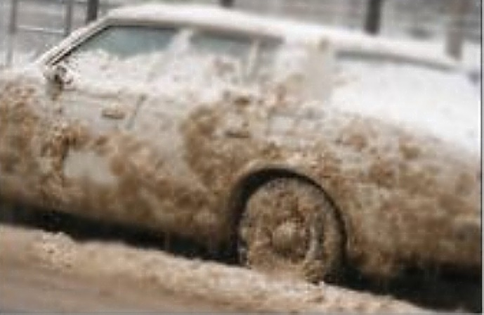
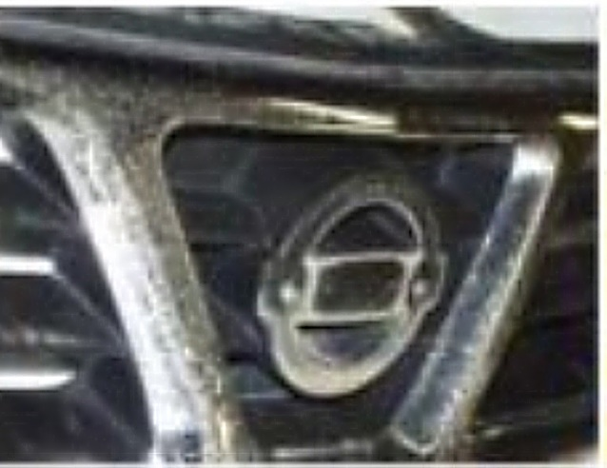
Russian Mud???
Background:
Russians love cars with decorative chromium
2006-7, Winter in Moscow was very cold with lots of snow
City crews changed to calcium chloride for street de-icing
Decorative Cr on new cars corroded in just a few winter months
Why Calcium Chloride vs. NaCl?
Melts ice 8 times faster
Works down to -25ºF (exothermic reaction) vs. 12ºF for NaCl
Does not form dust
Can be applied before a storm
Winter in Moscow, 2006-7
Photo, courtesy of Don Snyder, Atotech USA

Slide 5
Ni-Cr Corrosion Protection Options:
Ni Layers | Cr Type | Comments
SBN + BN | Cr⁺⁶ or Cr⁺³ | Outdoor, non-vehicular applications
SBN + HSN + BN + MPN | Cr⁺⁶ | Parts perform well in 96 hr. CASS, 480hr. NSS, but poor results in Russian Mud, brake dust exposure
SBN + HSN + BN + MPN or SBN + HSN + BN + NN | Cr⁺³ | Parts perform well in Russian Mud exposure, but poor results in CASS, NSS and brake dust
SBN + HSN + BN + MPN or MP-EN-P | Cr⁺³ + Passivate | Parts perform well in Russian Mud exposure, as well as CASS, NSS and when exposed to brake dust
Notes:
Satin nickel can be substituted for bright nickel
Copper can be applied as an under-plate to SBM, but the nickel thickness required is almost the same
Thickness of nickel layers depends on the type of substrate
Recommendations can be found in ASTM B456

Slide 6
Passivation of Cr⁺³ Deposits
Options:
Immersion in Cr⁺³ solution*
Chromium phosphate (CrPO₄), g/L: 20-35
Oxalic acid, g/L: 6-12
Phosphoric acid: to pH 1-1.5
Temperature: 35ºC
Time: 5-30 seconds
Cathodic treatment in Cr⁺³ solution**
Basic chromium sulfate (Cr₂(SO₄)₃, g/L: 10g/L
Sodium gluconate, g/L 3.8g/L
Temperature: 25ºC
pH: 3.5
CCD: 0.5-1.0A/dm²
Time: 40-240 seconds
*per EP3502320A1 **per US10415148

Slide 7
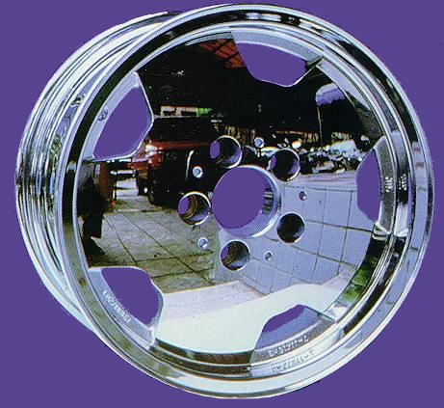
Introduction
Typical Corrosion Resistance Requirements*
Test | ASTM | Hrs. | Requirement
Neutral Salt Spray | B117 | 480 | No visible change
CASS | B368 | 22-96 | No visible change
CASS (active sites) | B456 X5 | Test is conducted after CASS exposure | 2,000/cm², active sites should average <0.032mm in diameter, no pit larger than 0.0635mm in diameter
Russian Mud | B995 | Variable | Rating = 5 (No visible change) Rating = 4 (Slight haze/stain no attack on Cr)
* For exterior automotive and motorcycle parts.
Requirements may vary significantly from one manufacturer to another

Slide 8
The CASS Test, ASTM B368
(Copper Accelerated Salt Spray)
For decorative electrodeposited coatings
Nickel/chromium coatings
Copper/nickel/chromium coatings
Substrates designed for severe service:
Steel
Zinc alloys
Aluminum alloys
Plastics
Others
Also applicable for anodized aluminum

Slide 9
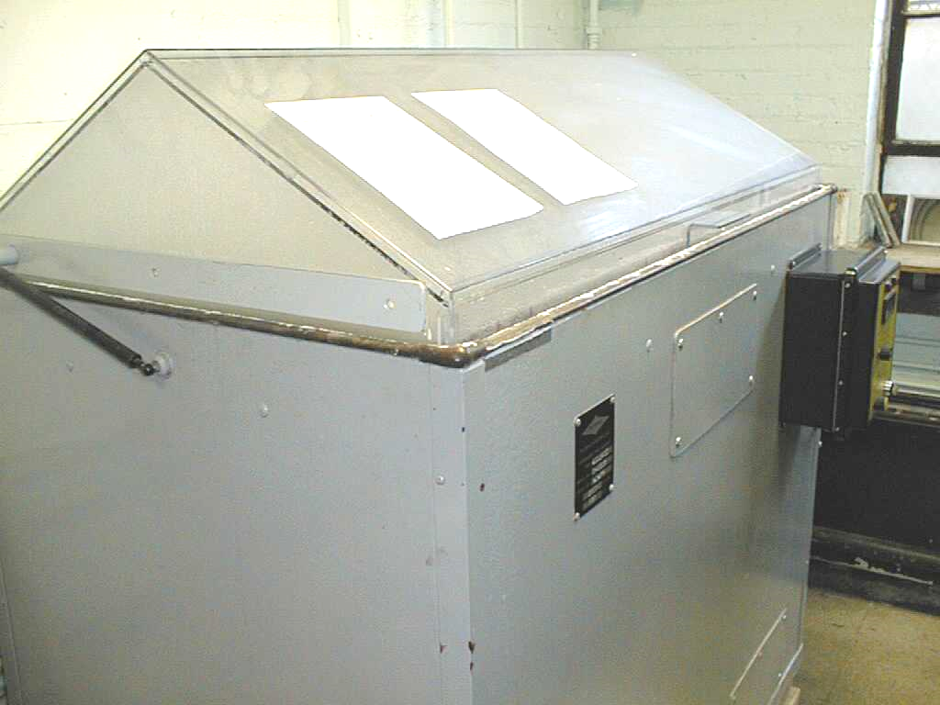
CASS vs. Salt Spray
Operating Parameter | CASS | Salt Spray
Temperature, ºC | 49 +/-1 | 35 +/- 2
Salt Solution | 5% NaCl + 0.25g/L CuCl₂ | 5% NaCl
pH | 3.1 to 3.3 | 6.5-7.2
Collection rate | 1-2mL/hr/80cm² | 1-2mL/hr/80cm²
Verification test panels | Nickel | Steel
Part prep | Cleaning required | Usually not cleaned
Exposure angle* | 15-30º, 180º | 15-30º, 6º
pH Adjust | Acetic/NaOH | HCl/NaOH
Notes:
Equipment used for each test is the same
Do not use one chamber for both tests
* 180º exposure is for automotive parts that are installed in a horizontal orientation, 6º exposure is typically in Boeing/aerospace specifications

Slide 10
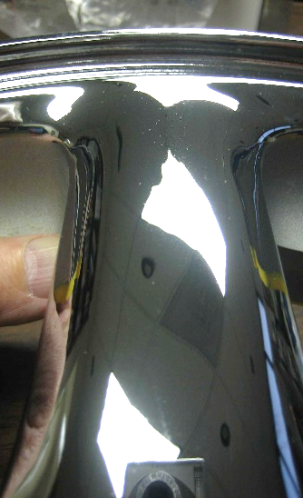
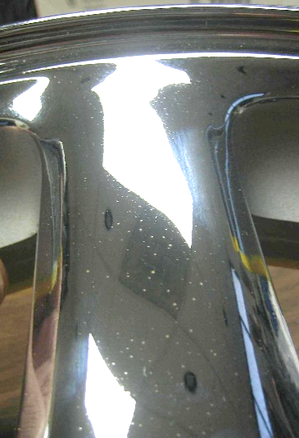
Evaluating CASS Test Specimens
ASTM does not indicate what constitutes a pass or fail for the CASS test, leaving interpretation to the part manufacturer
Requirements vary significantly
Some OEMs require “no change”
Other OEMs may indicate a certain number of corrosion spots, none larger than a specific diameter
Another criteria that may be used is the number of “active” corrosion sites detected after exposure
GMW 264 Acceptable (top) and unacceptable (bottom) results

Slide 11
Determination of “Active” Pore Density
Principle:
“Active” sites per unit area may more closely match CASS performance in tests longer than 24 hrs.
Procedure:
Subject part to “normal” CASS exposure
Rinse, dry the part
Strip chromium deposit (ASTM provides no guidance on stripping method)
Using a microscope at 100-200X, count the “active” sites
Active sites are typically larger and have a darker/rougher texture
Average diameter should be <0.032mm, largest pore should not be >0.0635mm in diameter
Acceptable active pore density is determined by each OEM
GM 4372/73/74M require a minimum of 2,000 active pores/cm²
2,000/cm²
10,000/cm²
Active pore charts from GM4372-3-4M

Slide 12
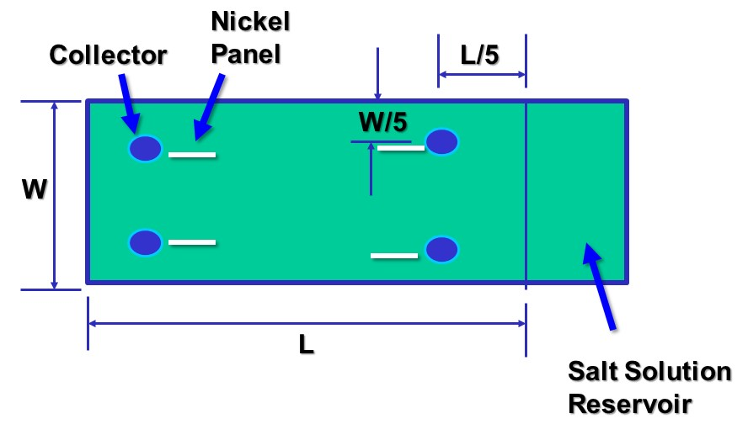
Calibrating & Standardizing Corrosive Conditions Within Cabinet
Use 4 nickel panels (specification B162, <0.15% C)
10 X 7.5 cm, approximately 0.09 cm thick
Weigh each panel on an analytical balance (to 0.001g)
Using plastic supports, place one panel at 30° from vertical, in each corner of chamber
Panels should be on the inboard side of condensate collectors, parallel to the cabinet length
The top of the test panels should be at the same height as the top of the condensate collectors
30°

Slide 13
Calibrating & Standardizing Corrosive Conditions Within Cabinet
After 22 hour exposure:
Rinse panels in DI water
Immerse in 20%vol HCl @20-25°C, for 2 minutes
Handle panels with (preferably) non-metallic tongs
Rinse in room temperature water
Rinse again in warm 38°C flowing water
Dry panels in 100°C oven for 10 minutes
Cool to room temperature (preferably in a desiccator) and re-weigh each panel
Target corrosion rate = 0.45 - 0.85 mg/cm²

Slide 14
Factors Affecting The
Corrosion Rate of Nickel Test Panels
New panels or panels stored for a long time may require 24-48 hours of CASS exposure before the weight loss per 22 hours stabilizes
Keep panels in an operating test chamber to avoid passivity
Passive panels can be HCl pickled and then CASS exposed until consistent weight loss is obtained
Round robin testing has discovered that the test has poor precision. Root cause is under investigation
Nickel weight loss too low:
Increase the spray pressure to increase the collection rate to the high end of the accepted range (2mL/hr)
Lower pH of the bulk salt solution to produce a pH of 3.1 in the collectors
Nickel weight loss too high
Use the opposite of the above recommendations

Slide 15
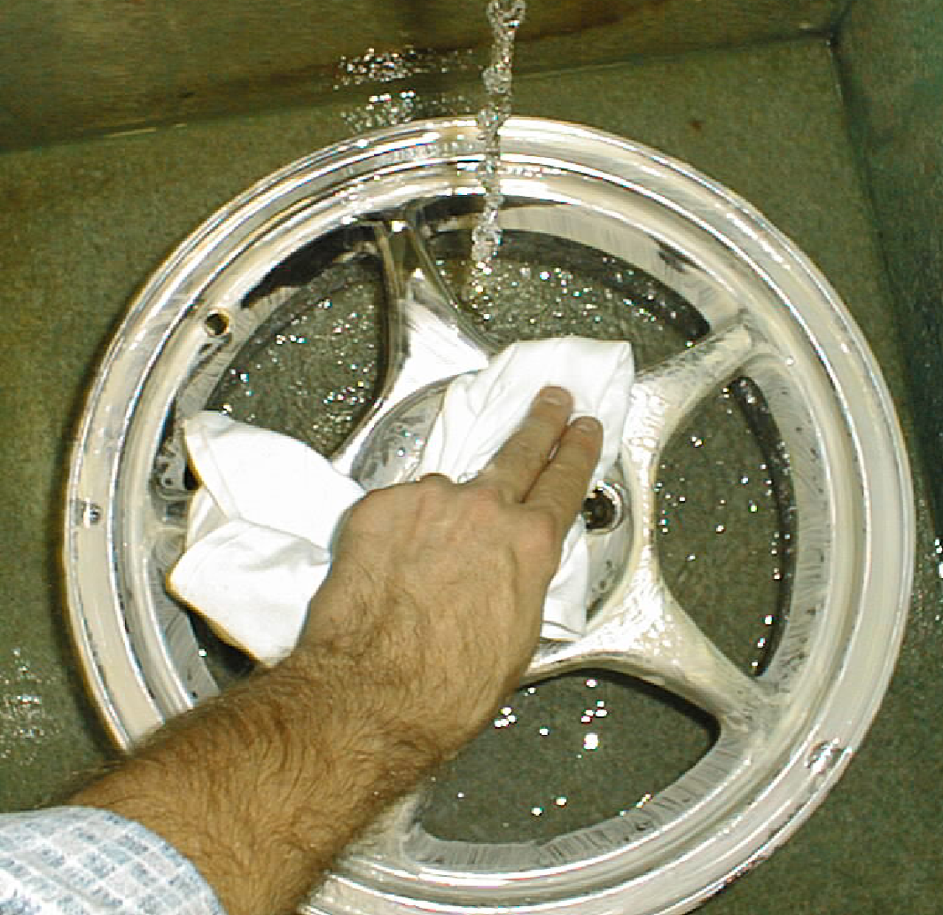
The Corrodkote Accelerated Corrosion Test, ASTM B380
For decorative electrodeposited coatings
Nickel/chromium coatings
Copper/nickel/chromium coatings
Substrates:
Steel
Zinc Alloys
Aluminum Alloys
Plastics
Others

Slide 16
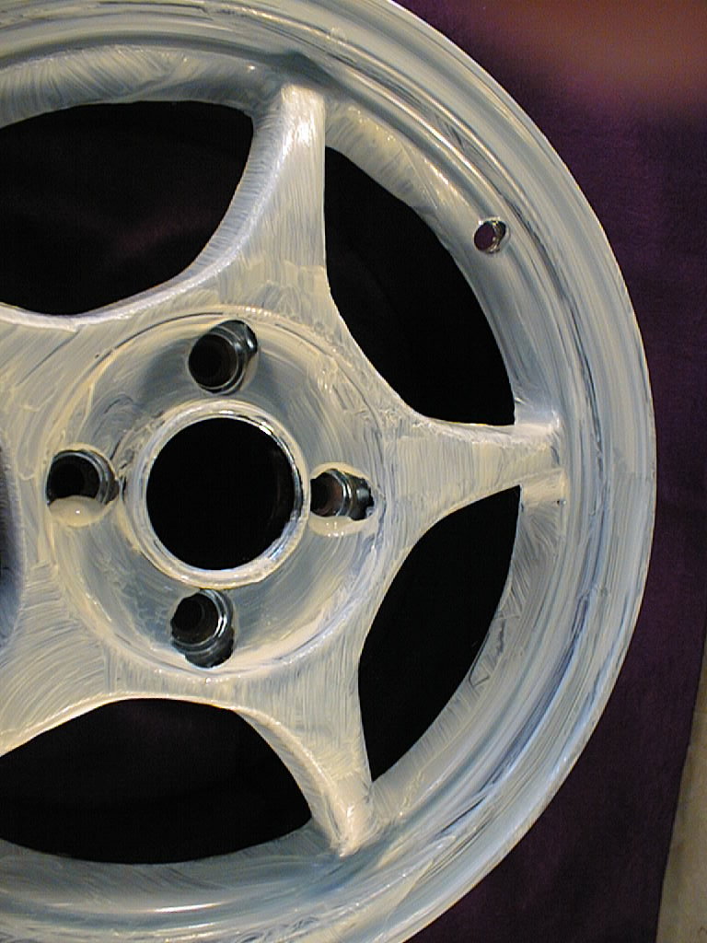
Overview of Corrodkote Test
Type & number of test specimens
Preparation of test specimens
Application of a slurry containing:
cupric nitrate
ferric chloride
ammonium chloride
Position of specimens during test
Conditions in humidity chamber
Test cycle
Period of test
Cleaning of testing specimens

Slide 17
Corrodkote Exposure Chamber
Can use modified salt-spray cabinet
Standard specimen supports
Controlled temperature & humidity
102°±2°F (38°±2°C)
Relative humidity @ 80 - 90%
No condensation on any of the test parts
Provision for air circulation

Slide 18
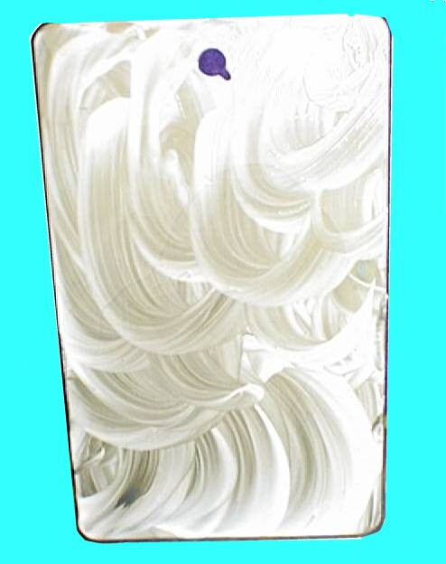
Slurry Application
Apply Slurry with Clean Paint Brush
Apply with circular motion
Completely cover specimen
Smooth out coating
Allow Specimens to Dry
Room temperature
Relative humidity <50%
1 Hour before placing in humidity chamber
Cut Edges Protected by Coating
Paint
Wax
Tape
Partially covered test panel shows swirling pattern obtained with brush

Slide 19
Corrodkote Test Cycle
Cycle definitions:
One cycle = continuous exposure up to 20 hours
Continuous operation = humidity chamber closed, operation interrupted briefly for placement or removal of test specimens
Wash off slurry and apply fresh slurry for successive cycles
Time period & # of cycles determined by OEM
Typical corrosion site development options:
4 hrs. salt spray
24 hrs. @ 100% condensing humidity

Slide 20
Russian Mud Test, ASTM B995
Test Chamber:
Any ASTM B117 type chamber capable of controlling conditions at 60+/-3°C and 23 +/-5% RH
Parts must not touch each other or chamber walls
No drippage from one part to another
Test Slurry:
Prepare a stock solution containing 57.5g CaCl₂ per 94mL of water + 8 mL of 0.25N NaOH. The pH of this solution should be 9.5+/-0.5
Shelf life = 1 month
Mix 3 g Kaolin per 5mL of stock solution to produce a slurry.
Measure the pH of the slurry (after dilution with an equal amount of Type IV DI water). pH should be 7.0+/-.5
Shelf life of slurry = 12 hours

Slide 21
Russian Mud Test, ASTM B995
Specimen Preparation:
Clean test specimens with 50/50 mixture of isopropyl alcohol and Type IV DI water
Apply 0.6 mL of test slurry using a pipet to produce a circular spot (do not manually manipulate/spread the slurry)
Produce at least 3 replicate spots separated by a minimum of 1cm in all directions
Exposure:
Place specimens into test chamber so that the slurry spot is horizontal
Test duration and inspection intervals are not specified by ASTM

Slide 22
Russian Mud Test, ASTM B995
Specimen Evaluation:
At each inspection interval, wipe off the slurry and inspect using 10X magnification
Assign a rating at each spot per photos in ASTM B995-Appendix X1:
0 = complete or nearly complete loss of chromium
1 = 59+% chromium loss
2 = large localized chromium loss
3 = Slight chromium loss
4 = hazing or stain/no chromium attack
5 = no change
Rating “1”
Photo courtesy of Atotech

Slide 23
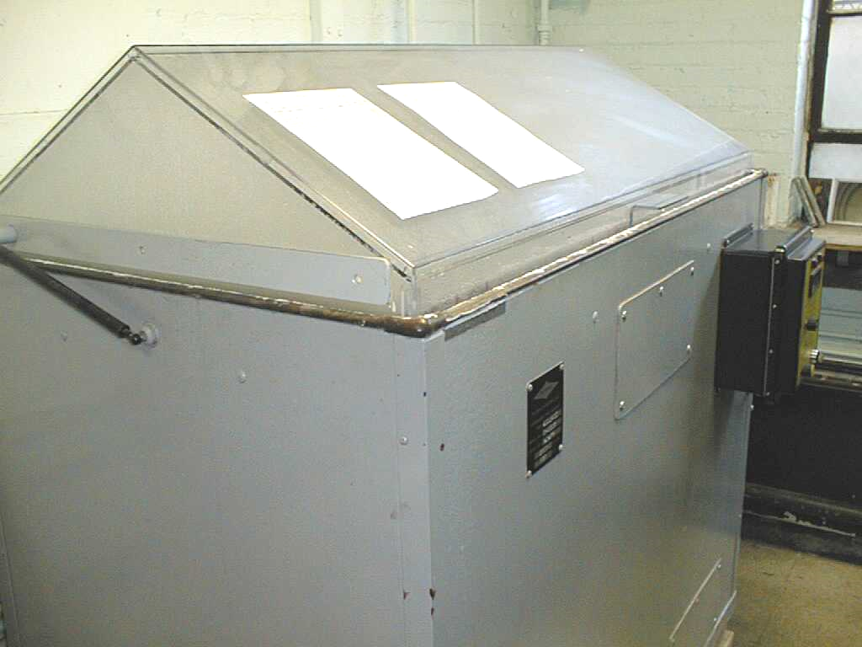
Acetic Acid Salt Spray ASTM G85, Annex A1
Useful for investigating the effect of operational parameter changes in an electroplating process
Equipment:
ASTM B117 cabinet
5% Salt solution
pH 3.1-3.3 (adjusted with acetic acid)
Cabinet temperature at 92-97ºF
Saturation tower temperature specified at 115-119ºF
Exposure angle 6-45º

Slide 24
Kesternich Test (ASTM G87)
Highly suited for finding faults in surface coatings
Not suitable for comparing performance relationships between different coatings
Overview:
Damp heat alternating atmosphere containing 0.2, 1.0 or 2.0 liters SO₂ in a 300L (10.6ft³) test chamber
Exposure Options:
“A”: 1-24 Hr. continuous cycle
“B”: 8 Hrs. SO₂ exposure at 40+/- 3°C (104°F) + 16 Hrs. at room temperature (cabinet open)

Slide 25
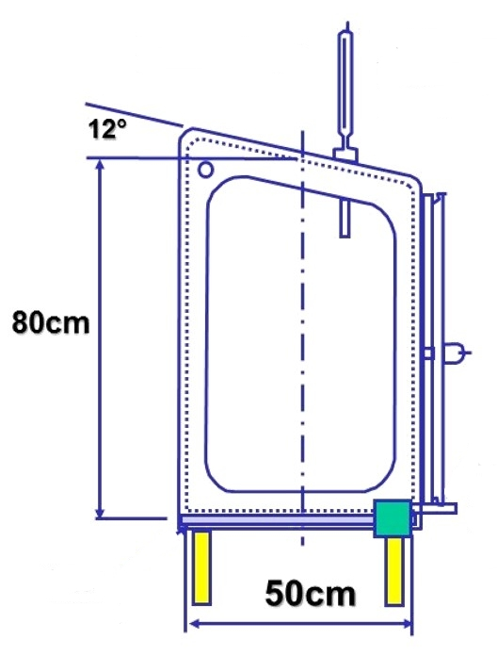
Kesternich Test
Cabinet:
Lead lined steel frame with glass walls
Pressure balanced with equalizing valves
Means of measuring/delivering prescribed volume of gas (as low as 0.2L) into the chamber (rotameter preferred)
Caution: Return of moist sulfur dioxide back into the cylinder can cause an explosion. Install check valve on line from cylinder to apparatus
Test Conditions:
Room atmosphere <75%RH
Protect from drafts/sunlight
Operate new cabinet for 10 cycles @ 2% SO₂ before conducting a real test
Thermometer
Water trough
Gas in

Slide 26
Kesternich Test
Test Specimen Exposure:
Introduce 2L distilled water into chamber
Place specimens at least 2cm apart, and at least 10cm from any wall or ceiling, at least 20cm above water in bottom of chamber
Angle of test surface is 0-10° from vertical
Introduce specified volume of gas
Heat chamber to 40+/-3°C in about 1.5 hours and then maintain temperature for duration of cycle

Slide 27
The End, Thank You!

